Slide 1
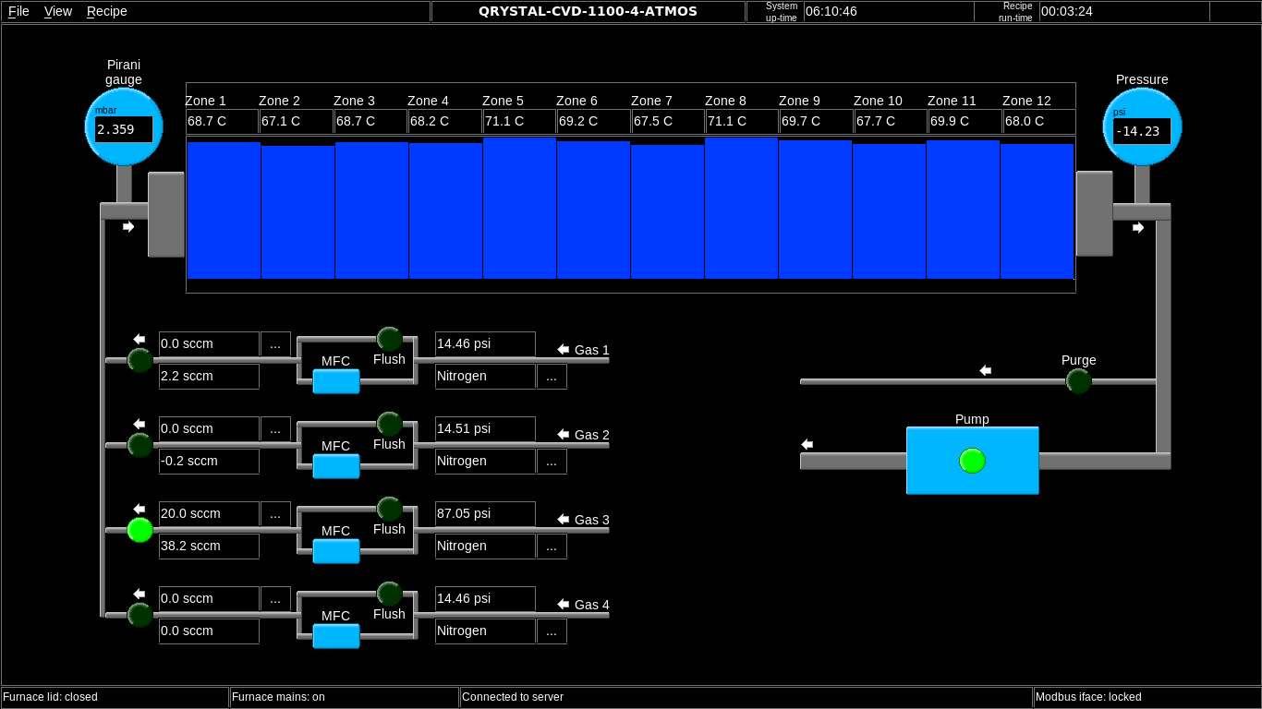
MFC (Channel 2) & Vacuum Pump: Not working properly

Slide 2
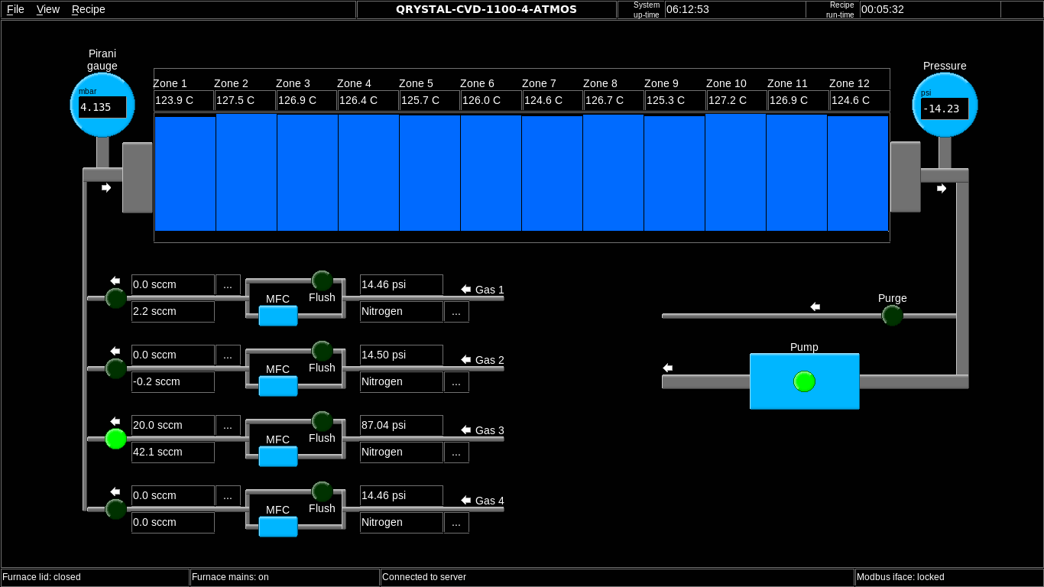

Slide 3
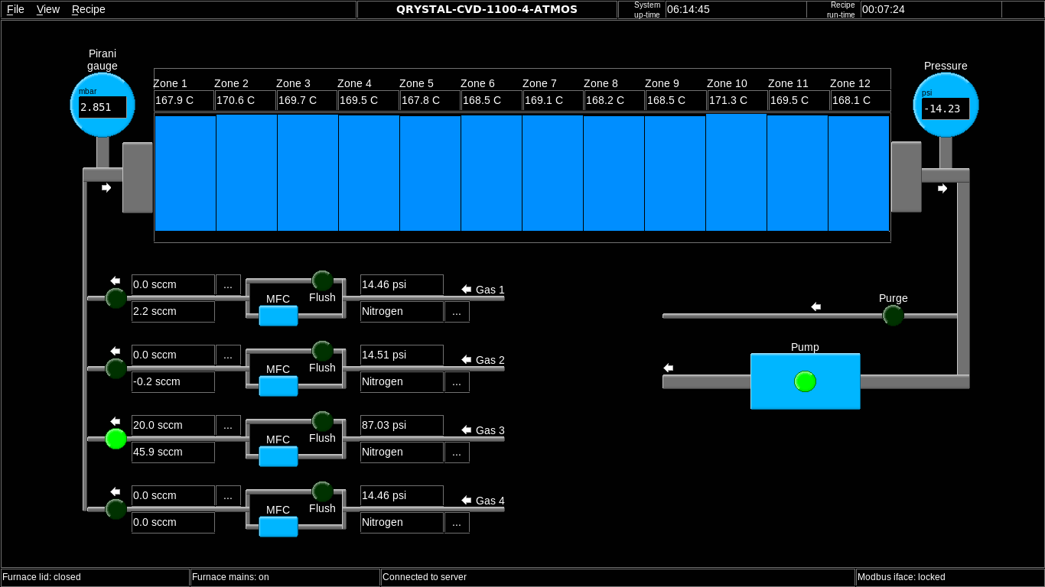

Slide 4
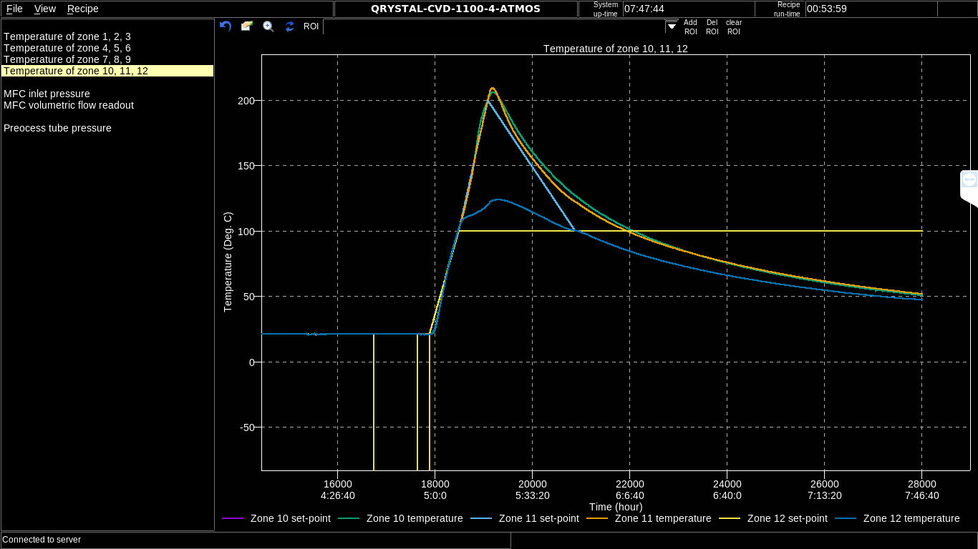
Temperature not maintained to 100° C

Slide 5
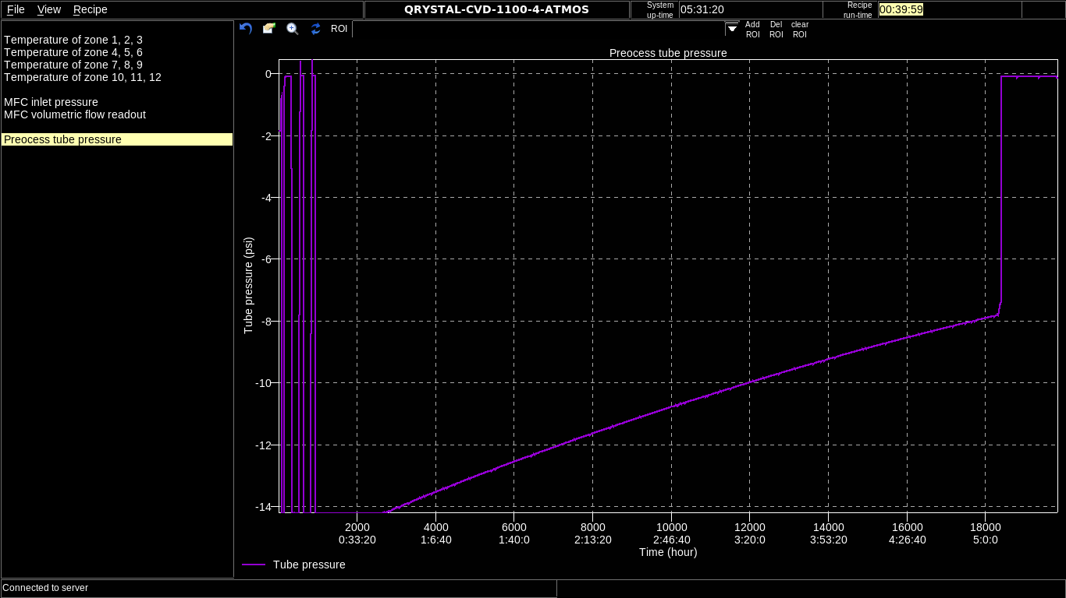
Pressure Profile
Pressure drops from 0.03 mbar to atmospheric pressure (>1.xx mbar) in less than 5 seconds.

Slide 6
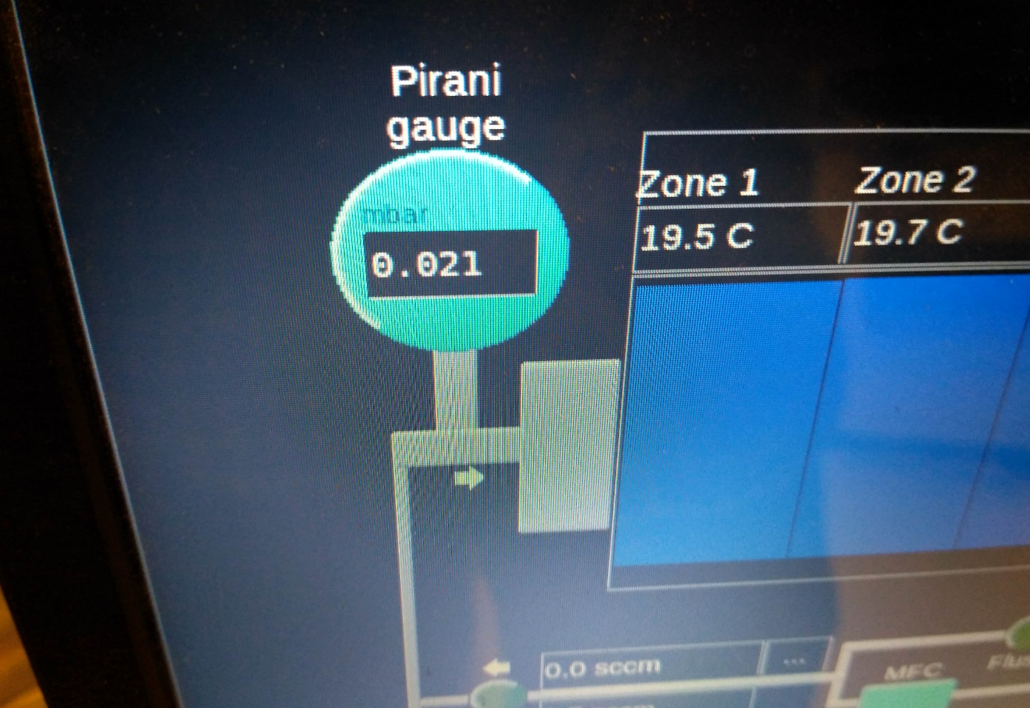
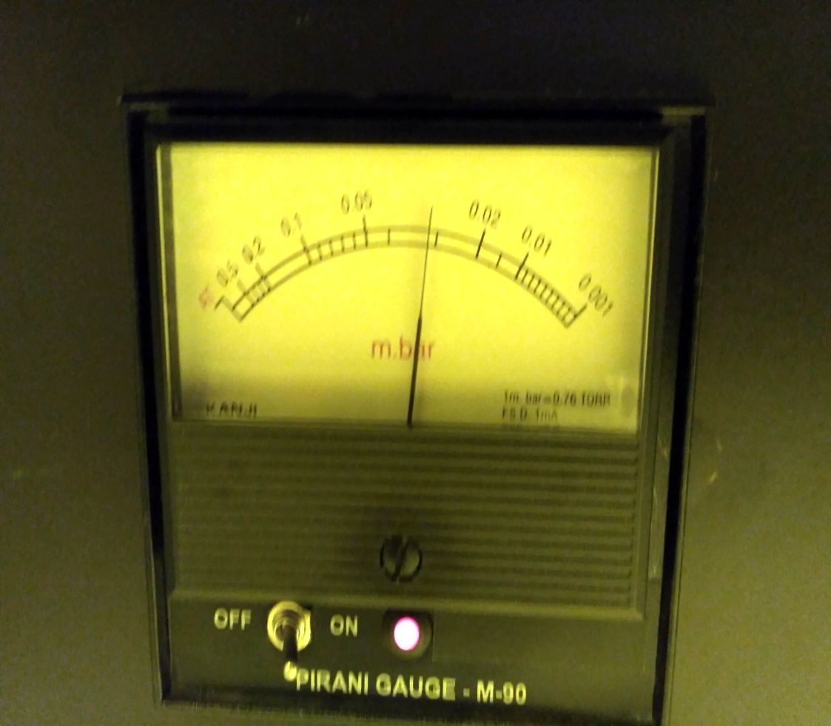
Pressure reading difference between analog & digital pirani gauge

Slide 7
Leak Test
Plastic O-rings
Metallic joints that holds the O-rings with the tube.

Slide 8
Other things to consider…
One way purge valve.
Preview window.
Command to abort a recipe (Needs an updated one)
Vacuum pump works occasionally.

